Slide 1
MONAI Label Walkthrough for RCC AI Assisted Annotation Project
01/14/2025

Slide 2
Getting started
Approximately following this walkthrough:
https://github.com/Project-MONAI/MONAILabel/tree/main/sample-apps/radiology

Slide 3
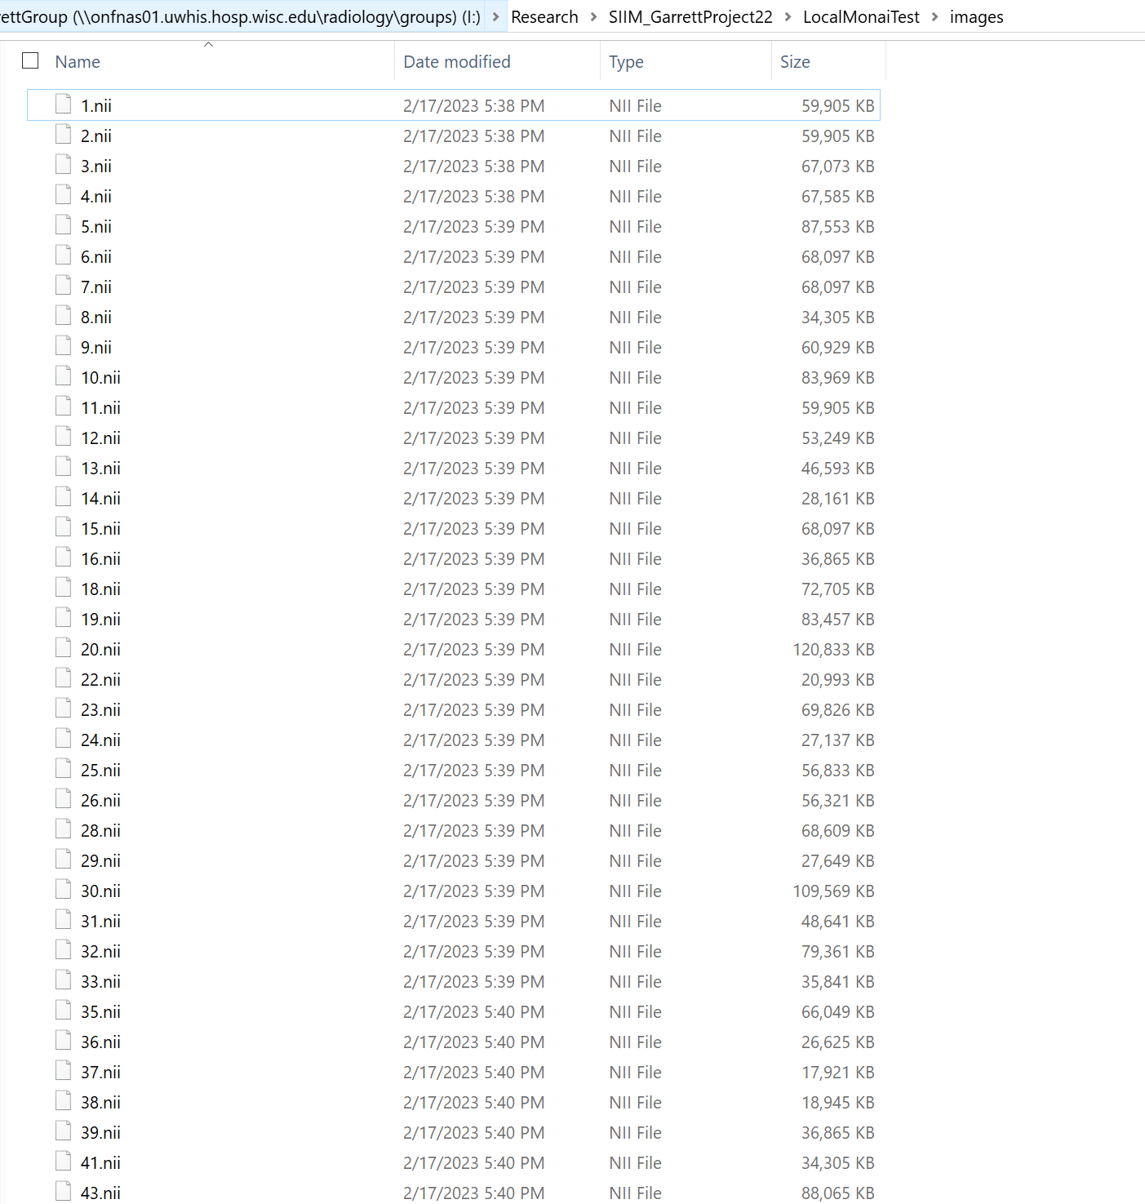
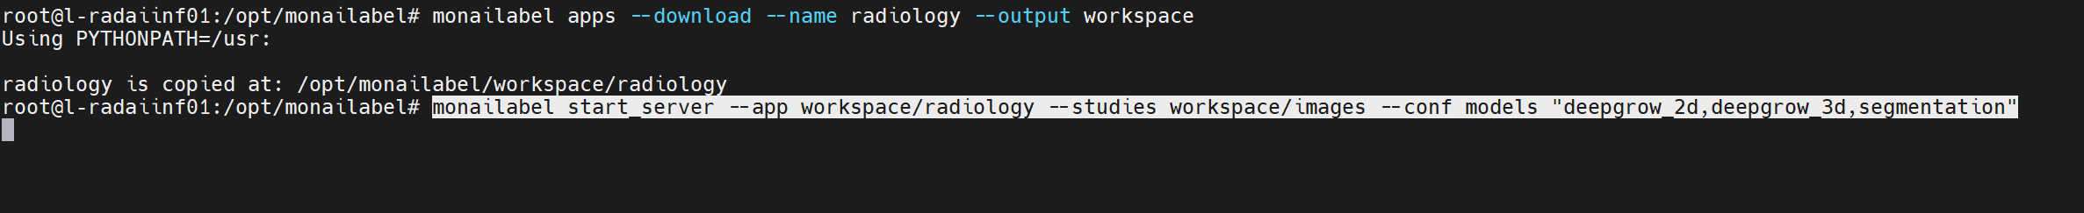
Start MONAI Label server (easiest via docker)
Launch docker:
Navigate to download radiology app and start server
When server is running will see a status like this:

Slide 4
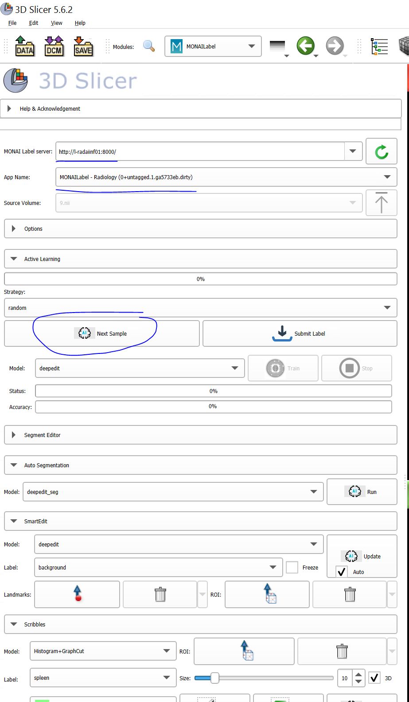
Connect to MONAI Label Server
Launch 3D slicer
Install MONAI Label plugin
Connect to server
Click Next sample to load first case

Slide 5
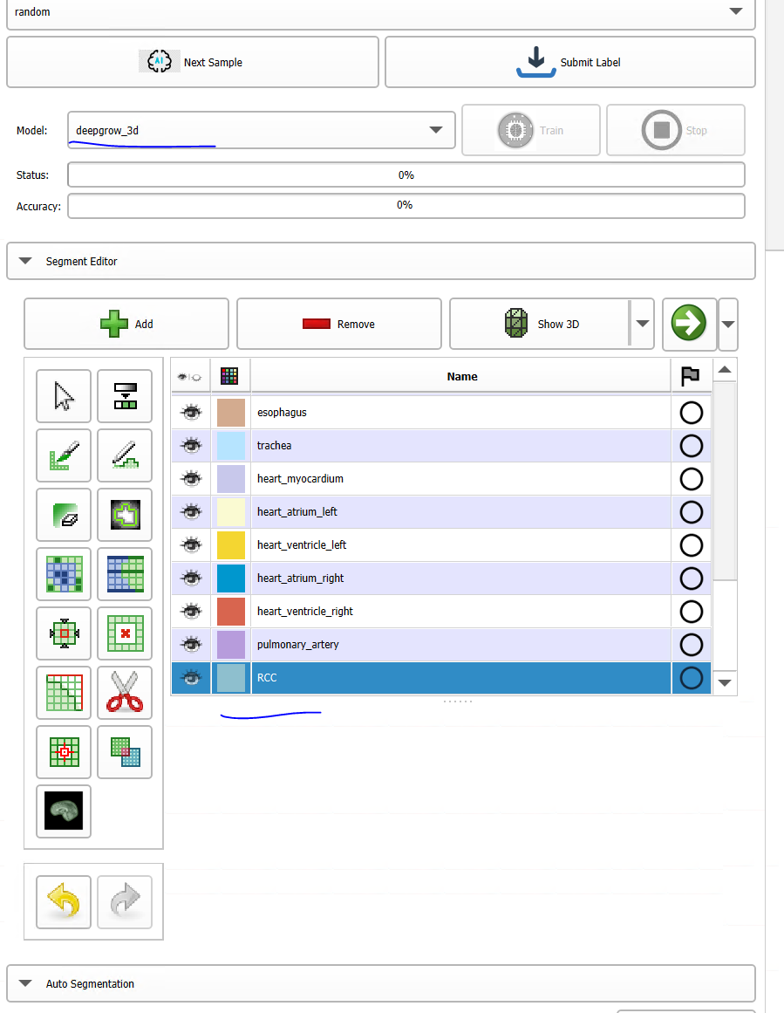
Begin annotation by defining relevant segmentation compartment

Slide 6
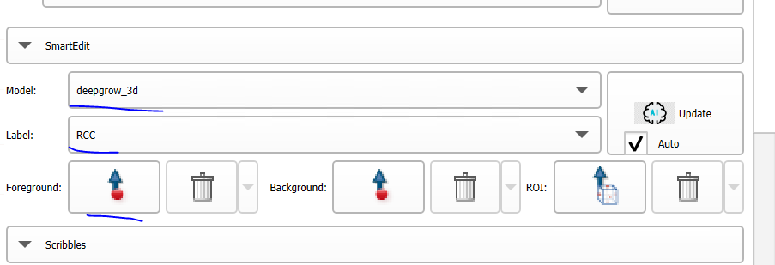
Chose deepgrow_3d and RCC compartment

Slide 7
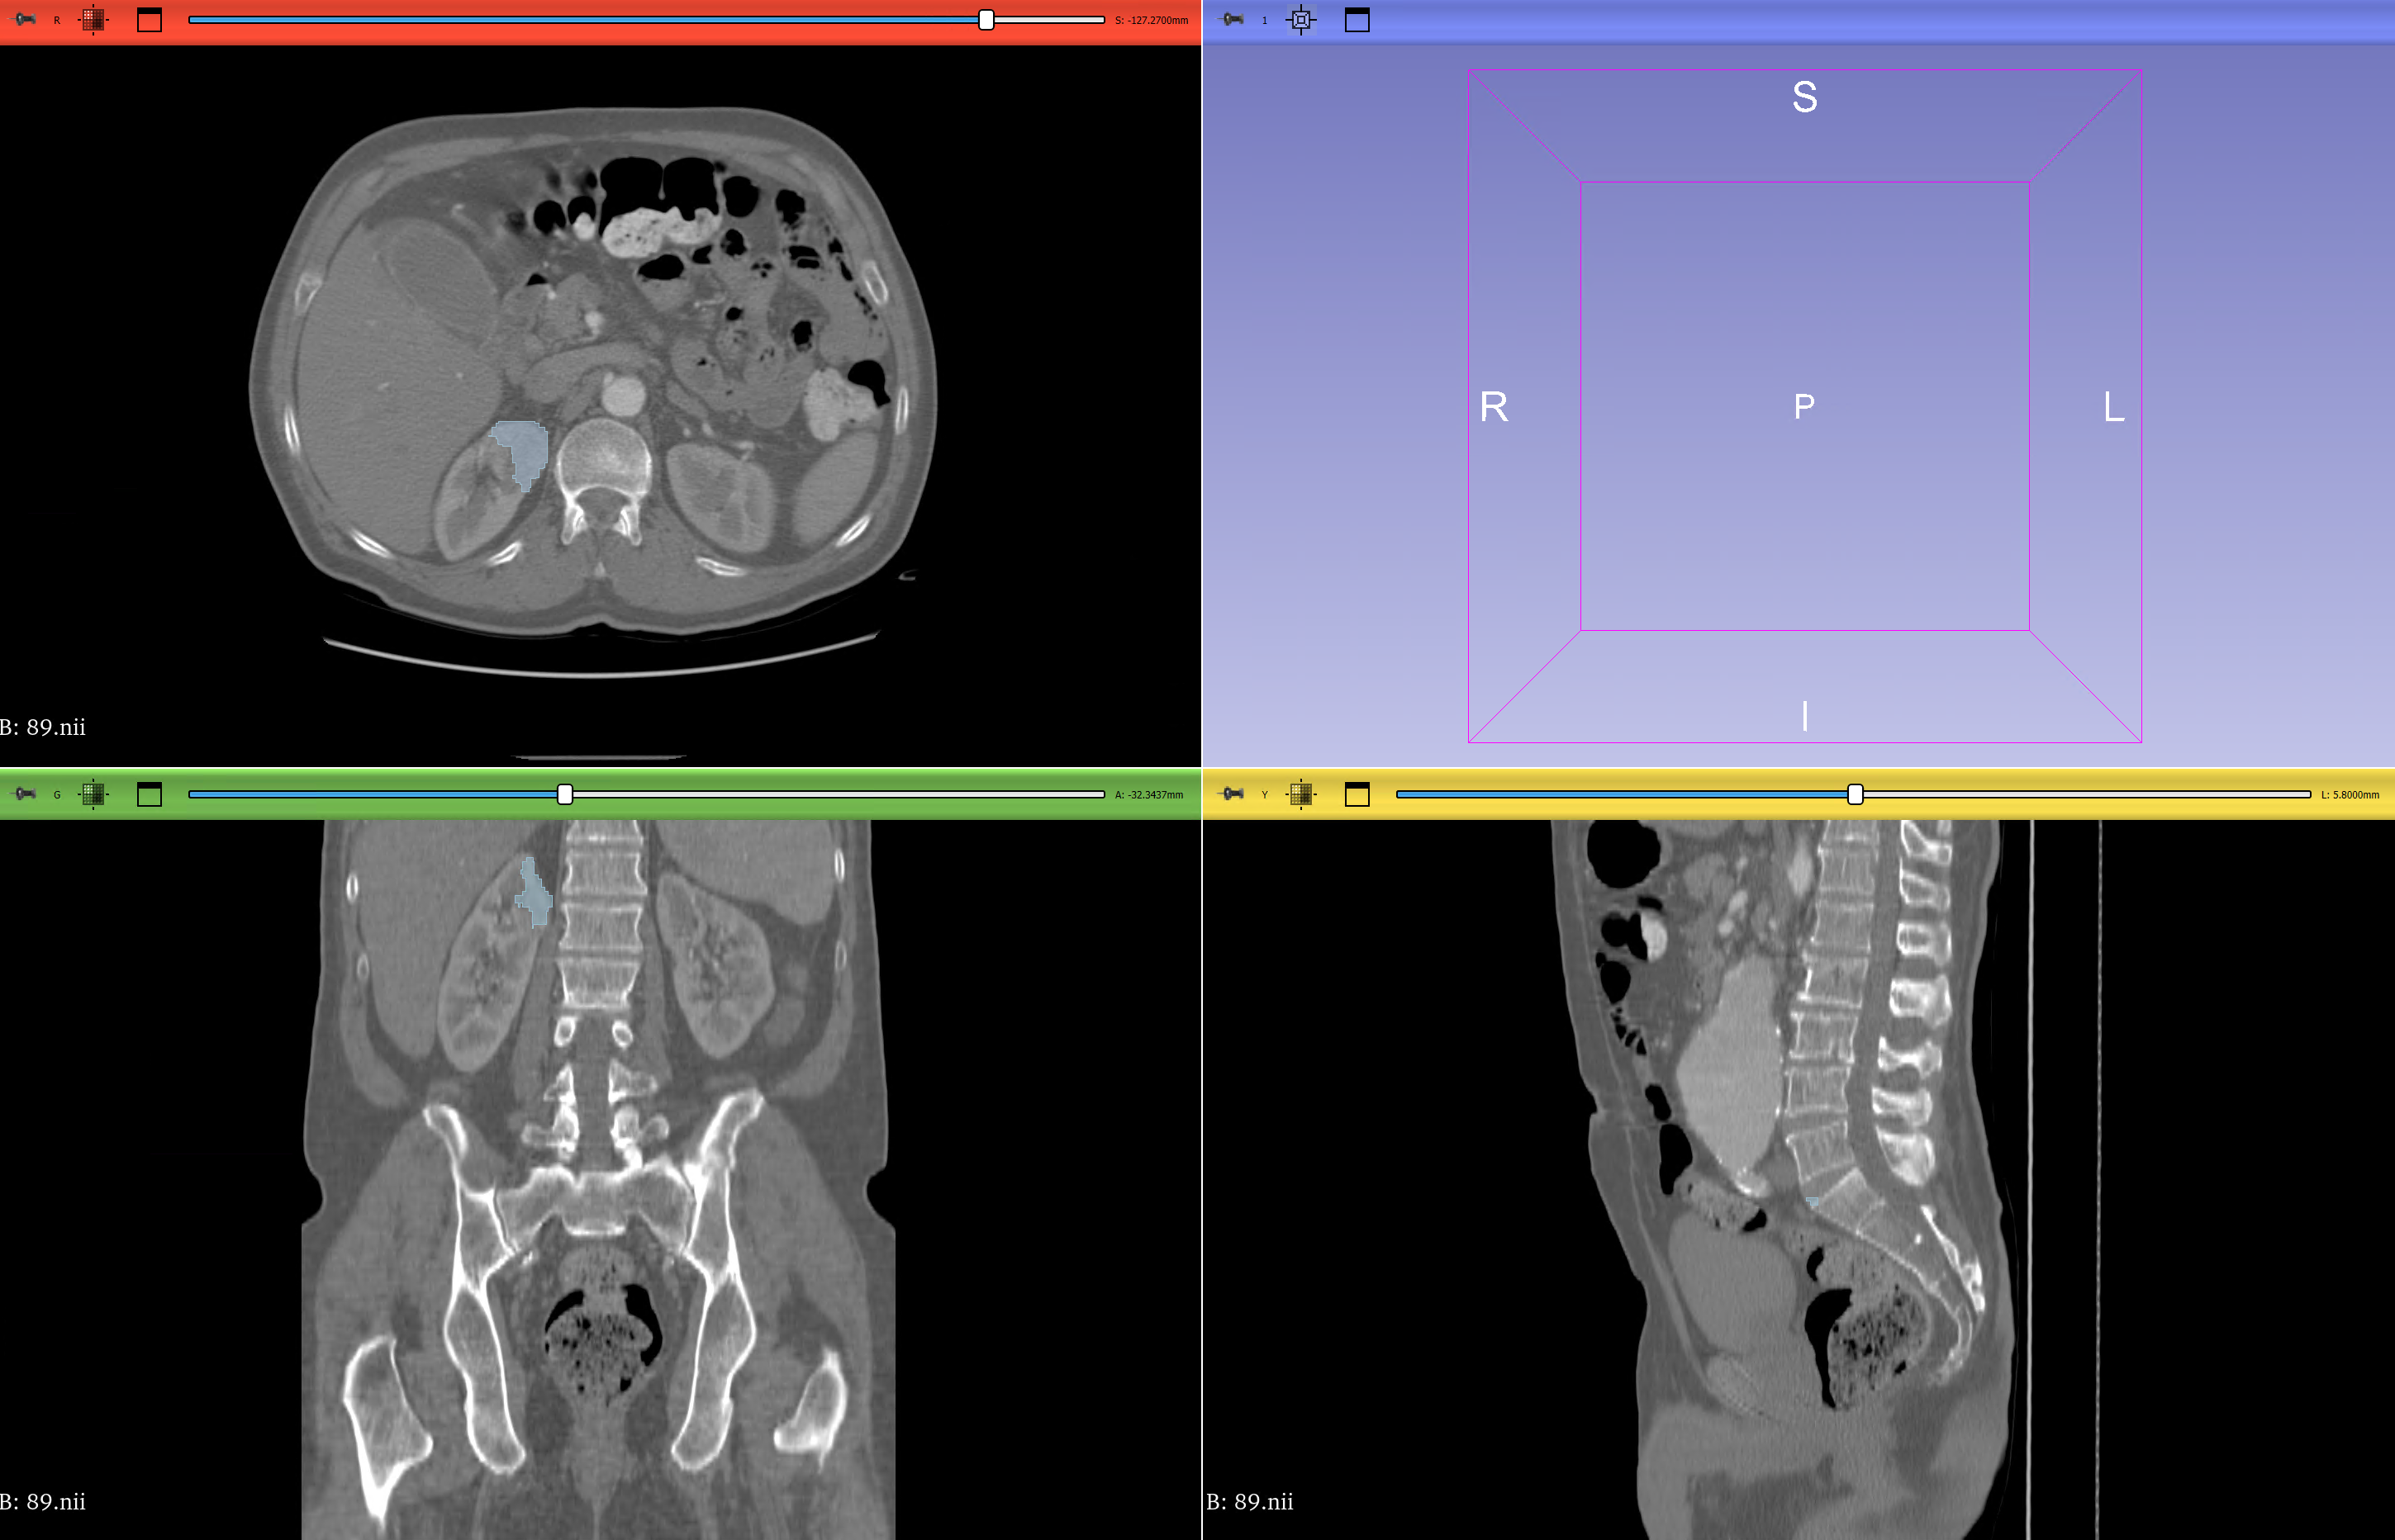
Start to place points and update segmentation
Place points in feature of interest
Update will autosegment that feature

Slide 8
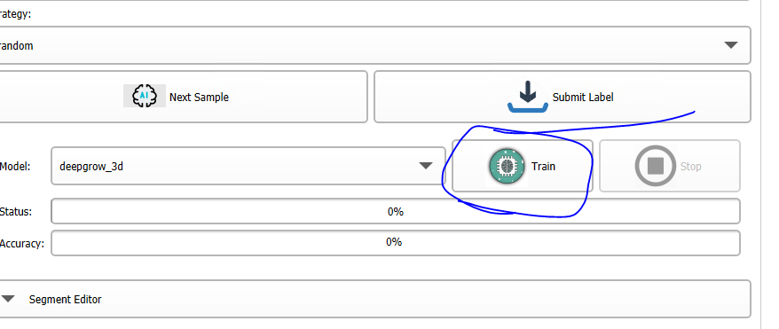
Submitting/saving labels and model improvement (to discuss?)
After a case is satisfactory, clicking “Submit label” will save label
An option is to then fine-tune the model using performed segmentations

